Slide 1
Modeling AI Industry Structure Using Knowledge Graph Embeddings
Alex Dillon

Slide 2
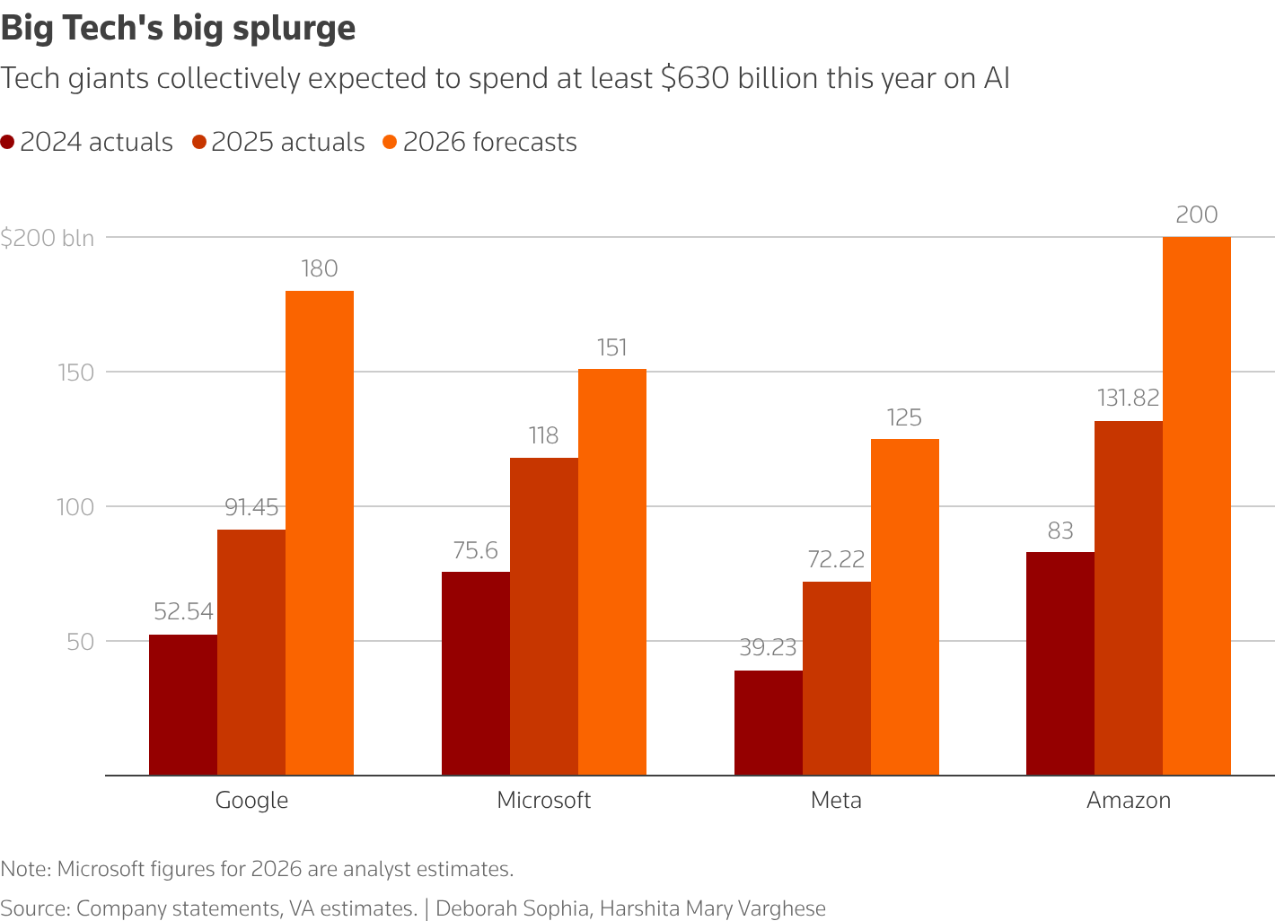
Introduction & Problem Statement
Mergers and acquisitions are central in shaping the technology industry
Large tech firms are increasingly acquiring AI startups to expand their capabilities and strengthen control over the industry
These deals change how firms are connected and how the industry is structured
M&A impacts occur across several number firms, not just individual transactions
Problem Statement: How does M&A activity reshape the structure of relationships among major technology firms in the AI industry?

Slide 3
Existing Literature
M&A in the technology market shows mixed effects on innovation and competition (Barnett; Ederer et al.; Fang et al.)
Big tech acquisitions often either discontinue or integrate startup products (Gautier & Maitry; Ederer et al.)
Acquihires increasingly prioritize talent over products, reshaping startup innovation and strengthening acquirer capabilities (Seitz & Lehmann; Choi; Benkert et al.)
Prior work focuses on firm-level acquisition outcomes, while this project models M&A as a network using embeddings and similarity measures

Slide 4
Data Collection & Construction
Subject | Predicate | Object | Date
META | ACQUIRES | MANUS AI | 29/12/2025
MANUS AI | IS_A | APPLICATIONS
MANUS AI | DEAL_VALUE | 2,000,000,000
MANUS AI | DEAL_VALUE_CAT | LARGE
MANUS AI | AMOUNT_RAISED | 85,000,000
MANUS AI | AMOUNT_RAISED_CAT | LARGE
MANUS AI | NUM_OF_EMPLOYEES | 120
MANUS AI | NUM_OF_EMPLOYEES_CAT | LARGE
Bin Definitions
Deal Value:
Small: ≤ $150,000,000
Medium: $163,000,000 – $1,000,000,000
Large: ≥ $1,300,000,000
Amount Raised:
Small: ≤ 9,850,000
Medium: 10,080,000 – 32,850,000
Large: ≥ 39,090,000
Number of Employees:
Small: ≤ 26
Medium: 27 – 60
Large: ≥ 62

Slide 5
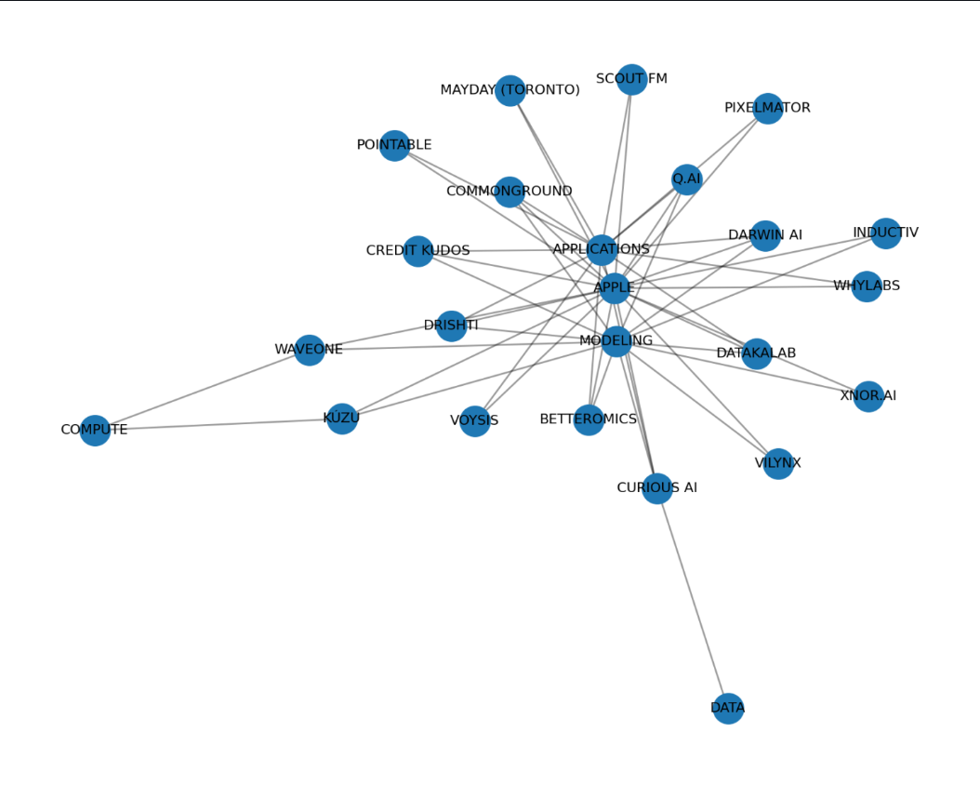
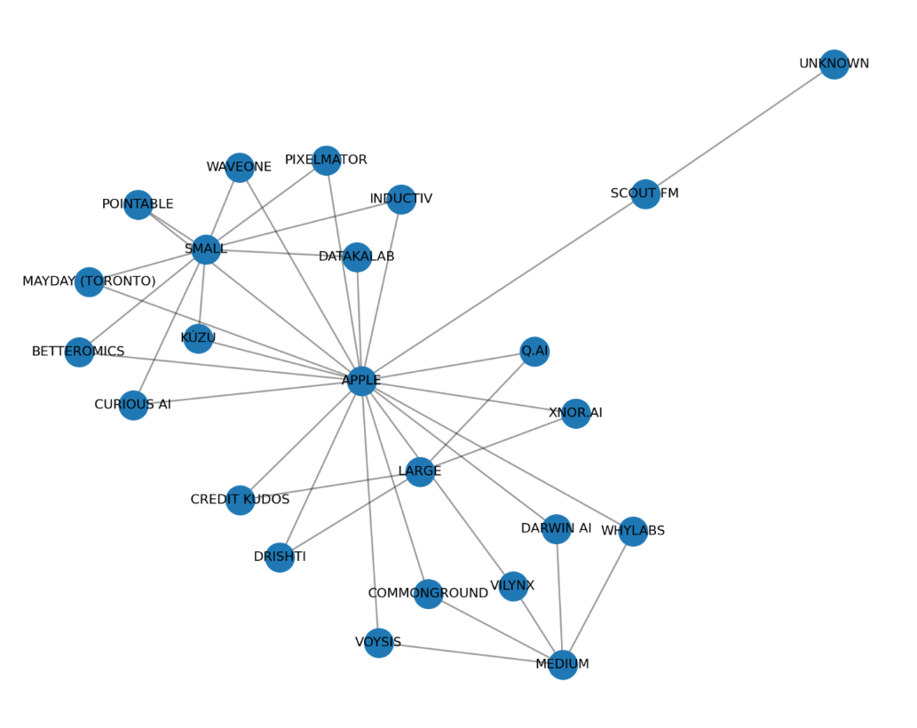
Modeling M&A as a Knowledge Graph
AI Category
Amount Raised

Slide 6
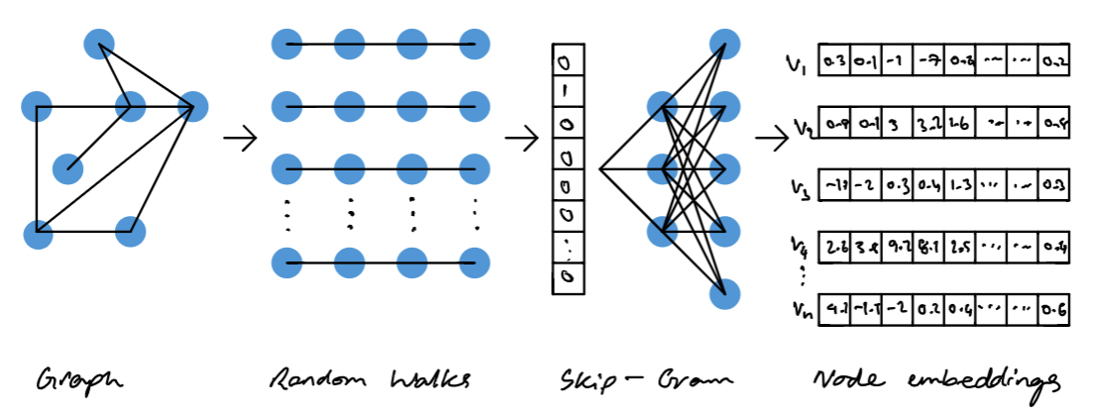
Methodology
Node2Vec learns structural embeddings from the acquisition network
Cosine similarity compares firms in the embedding space
TransE was explored as a knowledge graph embedding approach for acquisition relationships
Focus of analysis centered on Node2Vec-based embeddings
Better captures global network structure of firms
Node2Vec Embedding Process

Slide 7
Results/Discussion
APPLE | Firm & AI Company Type Similarity Score | APPLE | Firm & Bin Similarity Score
DATA | 0.08635391294956207 | SMALL | 0.36465710401535034
COMPUTE | 0.15919438004493713 | MEDIUM | 0.2631009817123413
MODELING | 0.39405983686447144 | LARGE | 0.18578727543354034
APPLICATIONS | 0.30912792682647705
Apple shows weaker similarity to compute and data focused firms, suggesting less infrastructure-related acquisition activity
Apple is most similar to modeling and applications companies in the acquisition network
Apple’s acquisition pattern is closer to smaller firms than larger firms in the network

Slide 8
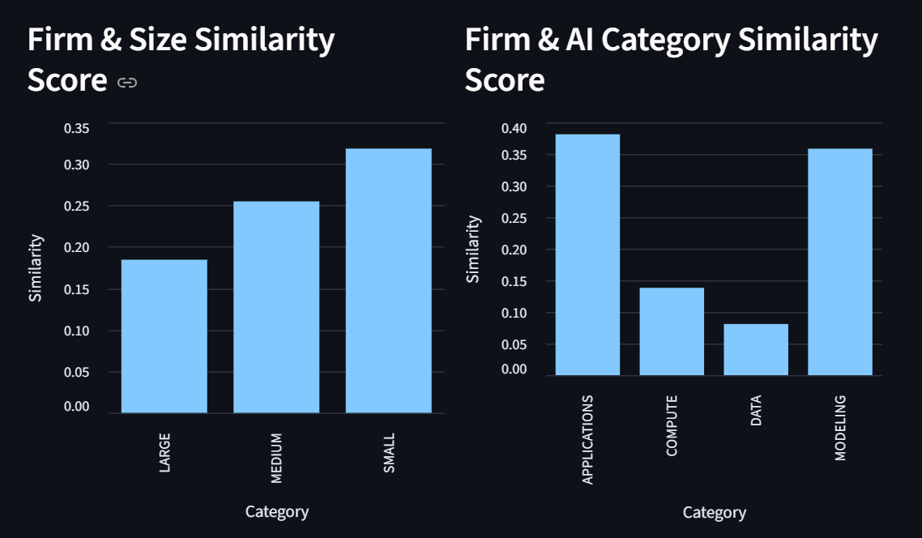
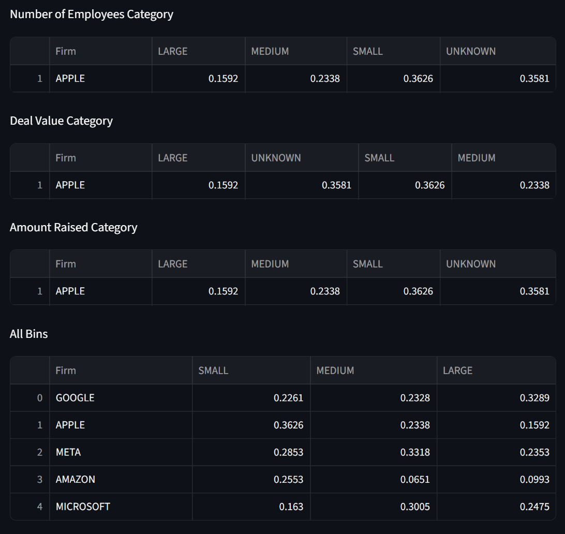
Testing & Visualization
Validation of similarity scores:
Compared cosine similarity scores with raw acquisition counts across AI categories and bins
Confirmed the similarity patterns reflect the acquisition data
Interactive dashboard
APPLE
DATA | 1 | 0.09 | SMALL | 18 | 0.36
COMPUTE | 2 | 0.16 | MEDIUM | 14 | 0.26
MODELING | 14 | 0.39 | LARGE | 7 | 0.19
APPLICATIONS | 15 | 0.31

Slide 9
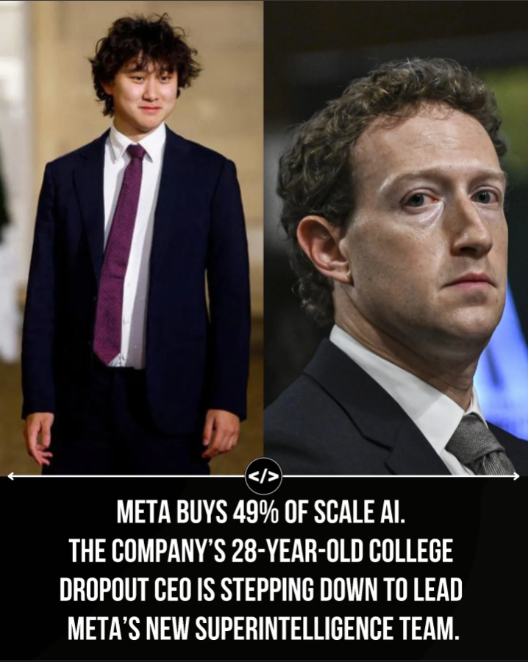
Future Work & Conclusion
Conclusion:
Node2vec embeddings effectively capture firm similarity in the acquisition network
Firms form different clusters across AI category areas and firms size bins
Specifically looking at Apple, they show stronger alignment with modeling and applications focused firms rather than infrastructure focused firms
Future Works:
Explore how different choices related to graph construction and dataset scope affect similarity results
Expand dataset beyond full mergers and acquisitions to include partial acquisitions, minority stakes, and strategic investments

Slide 10
Thank You!

